Slide 1
Zdeněk Horáček

Slide 2
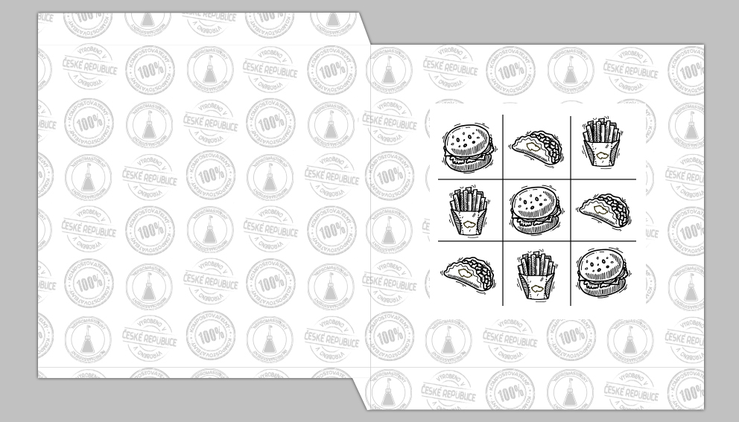
This work is designed for fast food paper. The fast food paper is special because it’s completely compostable and greaseproof.
In background you can see the vectors which are specially for it.
Design is inspired by the game five in row.
These paper are manufactured by KRPA paper s.r.o.

Slide 3
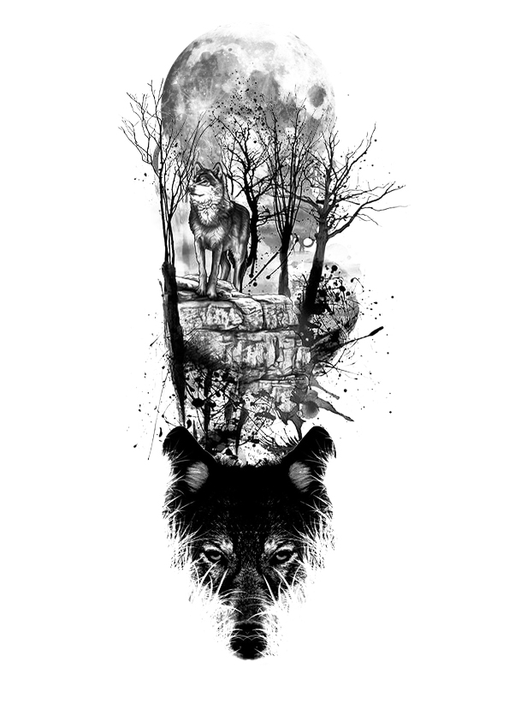
This is a tattoo sketch for my friend. The tattoo is designed for forearm. He really likes wolfs. The tattoo is created from photo and brushes in Adobe Photoshop.

Slide 4
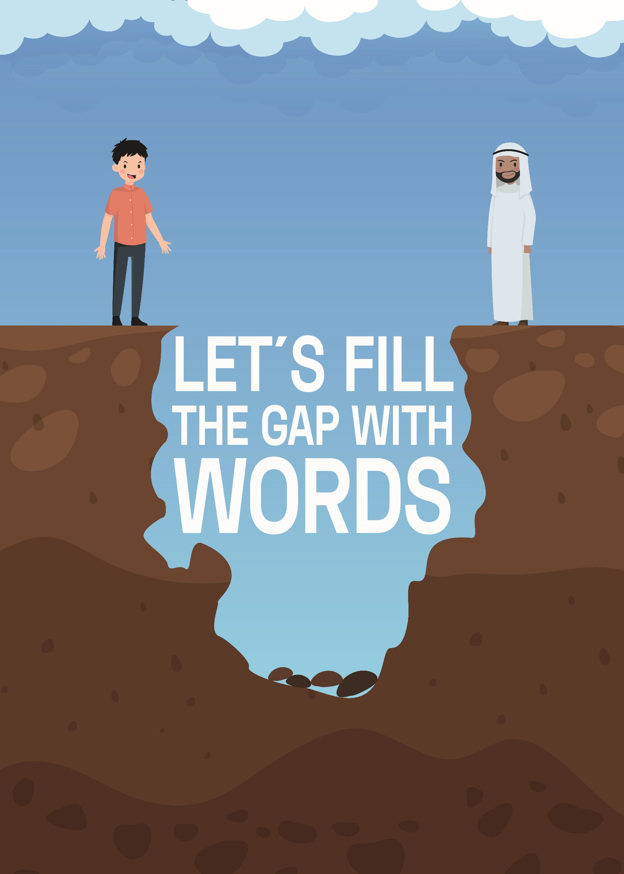
This is poster for international contest Posterheroes Topic: Integration
U can see an illustration of two different cultures. In the Integration is the biggest problem communication, therfore: Let´s fill the gap with words

